Slide 1

A Whole New Idea in higher education Staffing!
Presented by InChorus, Inc.
In Madison, WI
With InChorus, everyone wins!

Slide 2
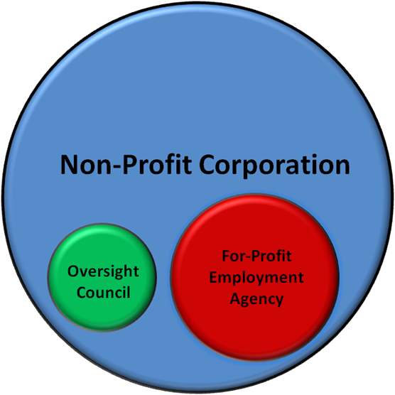
The organizational model

Slide 3
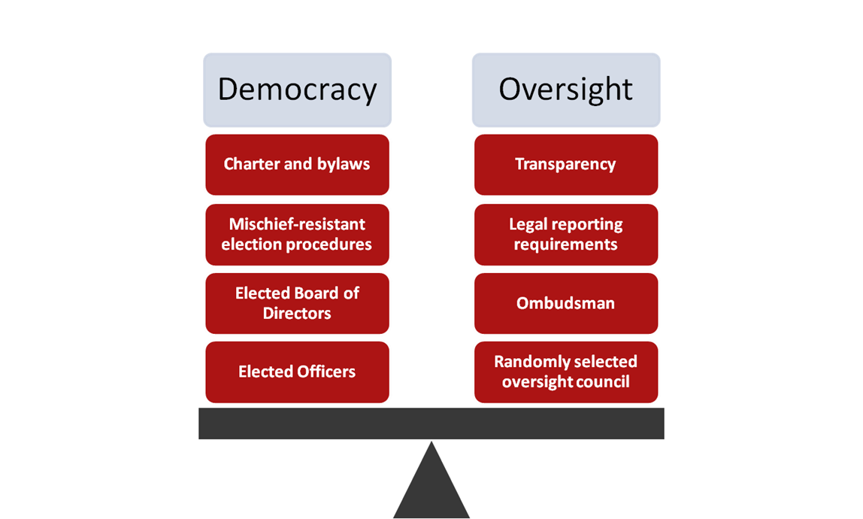
Organizational governance

Slide 4
Organizational functions
Administrative
Hiring part-time faculty
Certification
Training/ Professional Development
Course Assignments
Evaluations
Sick Leave/ Substitutes
Course Portfolios
Professional
Develop and implement professional quality improvement initiatives
Research and disseminate best practices for educators
Pursue and reward innovation in teaching
Improve the value of education for the community

Slide 5

Major advantages for PT faculty
Better job security and more course assignments (no load limits)
Current staff used to full desired potential before new staff are hired
Access to assignments at multiple campuses and at other colleges + uniform and transparent course assignment process
Higher quality and more frequent evaluations
Excellent teaching rewarded with higher priority for additional assignments
Better pay
Inclusive retirement system
Preservation of sick leave
Opportunity for organization to realistically explore benefits
Member control of organizational decisions and democratically elected leadership
Unprecedented level of organizational transparency and oversight
Significantly higher quality course portfolios and much easier access to portfolios
Incentives for 5-year certification, easy expansion of areas of certification and more flexible options for certification courses.
No dues or other costs to faculty, all overhead expenses captured in bid.

Slide 6

Major advantages for school
Cost savings of $3 million per year
Free up high value employees for other functions
Maximize flexibility for position redesign and/ or realignment
Maximize opportunities to take advantage of natural attrition and retirements
Ability to completely avoid any layoffs by front-end loading savings
Maximize flexibility in course offerings
Avoid concerns about overtime/ remove restrictions from PSRP teaching part-time
Avoid exposure to fines for uncertified staff
Avoid exposure to liability for payroll errors and unemployment claims
Significantly improve ease of scheduling and reduce paperwork
Improve the quality of instruction
Avoid harsh cost-cutting measures while preserving ALL current course offerings

Slide 7

Major advantages for students
No reduction of course offerings
No increase in class sizes
No reduction in operating hours
No closure of any sites
No reduction of off-campus offerings
No increase in tuition
No lay-offs of full-time instructors or support staff
Better quality instruction/ better supported part-time faculty
More experienced part-time instructors
Collaboration among instructors across schools and campuses, expansion of best practices
Quality improvement project #1- Learner Elective Format course offerings
Quality improvement project #2- Textbook free courses/ instructor generated materials

Slide 8
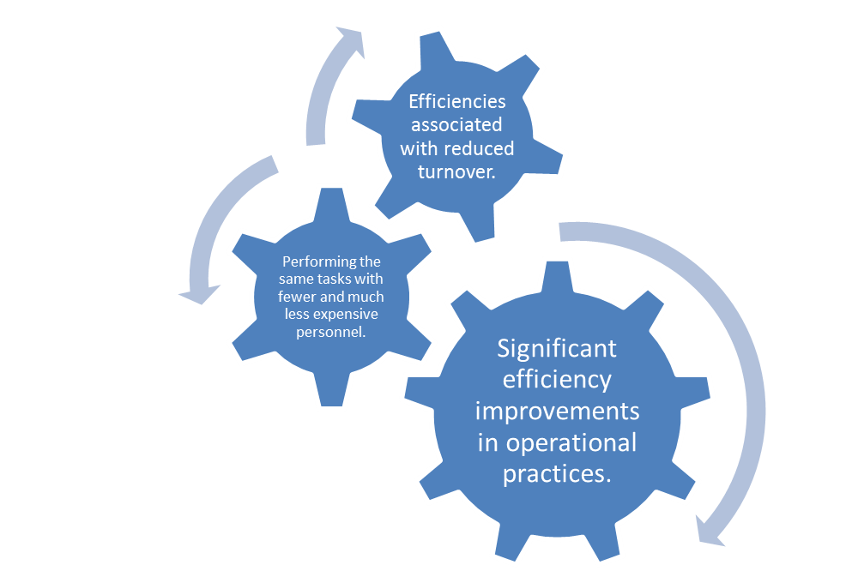
Cost savings
Our business plan has been evaluated and endorsed by our outside consultants- The Ashford Group. It is viable and sustainable in the long term. Our cost and revenue projections are objectively reasonable, and present a major cost saving opportunity for the college.

Slide 9
Implementation status
Focus is no longer on MATC District Board
High level of bipartisan interest in state legislature
Several different potential implementation paths
In the shadow of the recalls, we have the greatest amount of political leverage we’ve ever had as an organization
Delicate balancing act for our proposal to be a political achievement without becoming a political football.
Critical period is now January 1- June 1, 2012

Slide 10

Questions and answers
With InChorus, everyone wins!

