Slide 1
MATC Budget Update
Convocation
October 2011

Slide 2
MATC Budget
Operating Budget
Funds all operating expenses (e.g. wages, benefits, utilities, supplies, leases, etc.)
Subject to statutory mill rate cap
Capital Budget
Funds capital purchases (e.g. buildings, land, furniture, computers, etc.)
Total borrowing subject to caps, voter approval needed in some cases

Slide 3
Operating Budget
Three main sources of funds
Tuition
Set by state WTCS Board
State/Federal Aids
Set by State and Federal Legislatures
Trending down
Property taxes
Set by MATC Board of Trustees
Subject to mill rate cap of 1.5 ($1.50 per thousand dollars of property value)

Slide 4
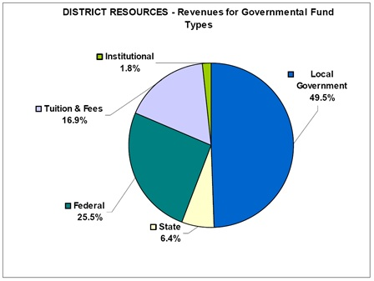
Sources of funds 2011-12

Slide 5
Property Tax Levy
Tax assessed on all taxable real property in the MATC District, (residential, commercial and industrial).
Residential Property = 70% of the total for the district.
The total value of all this taxable property (adjusted for exemptions) is called the “Equalized Value” of the district.
“Mill rate” is the tax charged, per $1000 of property. (This year it is about $1.32.)
Total tax levy = (Equalized value/1000) x mill rate.
(MATC’s levy includes an “operational” portion and a “debt service” portion.)

Slide 6
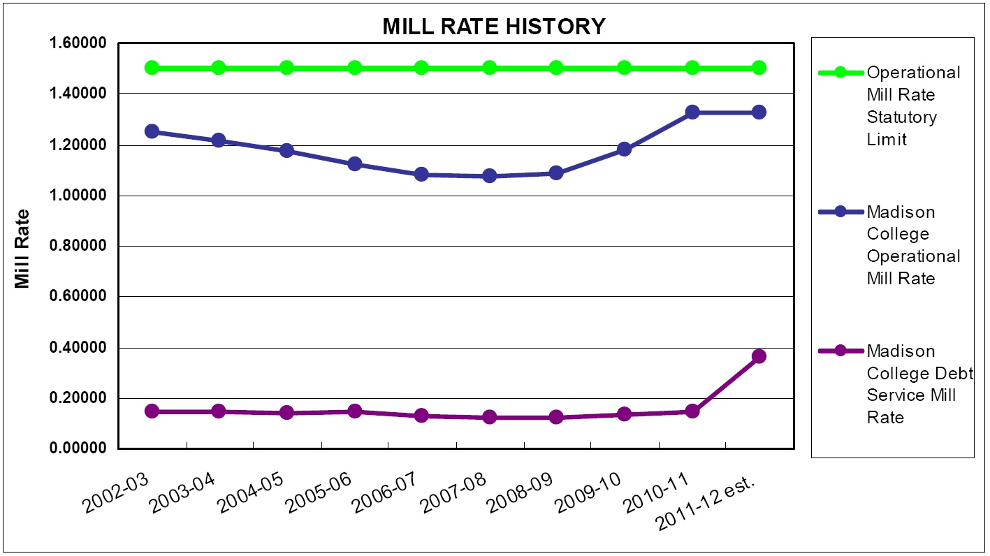
Property Taxes

Slide 7
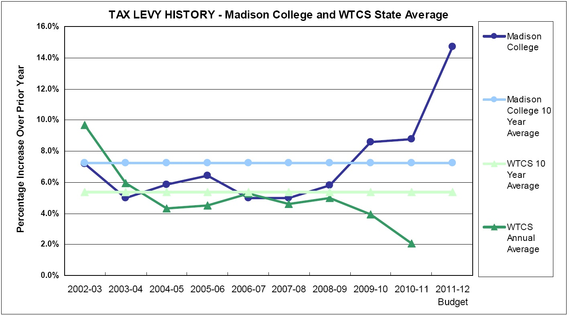
MATC Total Levy History

Slide 8
MATC Operating Levy History
Year | Operational Mill Rate (max=1.5) | Operational Levy | max levy | difference | cushion
2003-04 | 1.21479 | $59,341,471.19 | $73,273,740.15 | $13,932,268.95 | 19.0140%
2004-05 | 1.17453 | $63,063,767.55 | $80,539,152.96 | $17,475,385.41 | 21.6980%
2005-06 | 1.12063 | $66,334,089.40 | $88,790,353.74 | $22,456,264.33 | 25.2913%
2006-07 | 1.08148 | $70,227,164.36 | $97,404,248.38 | $27,177,084.02 | 27.9013%
2007-08 | 1.07491 | $74,086,203.60 | $103,384,753.52 | $29,298,549.92 | 28.3393%
2008-09 | 1.08671 | $78,432,398.52 | $108,261,263.61 | $29,828,865.09 | 27.5527%
2009-10 | 1.18113 | $85,383,769.05 | $108,434,849.31 | $23,051,080.27 | 21.2580%
2010-11 | 1.32749 | $92,926,111.46 | $105,002,046.86 | $12,075,935.40 | 11.5007%
2011-12 | 1.34174 | $92,926,111.46 | $103,886,792.37 | $10,960680.91 | 10.5506%

Slide 9
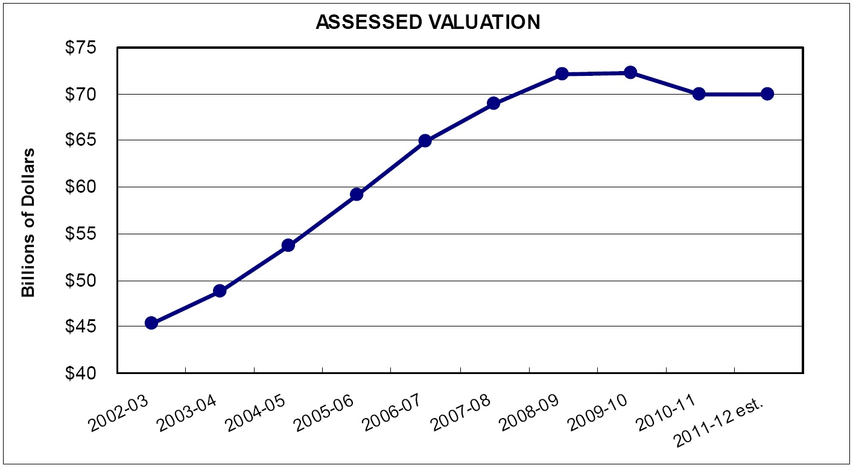
Property Values

Slide 10
Property Values (cont.)

Slide 11
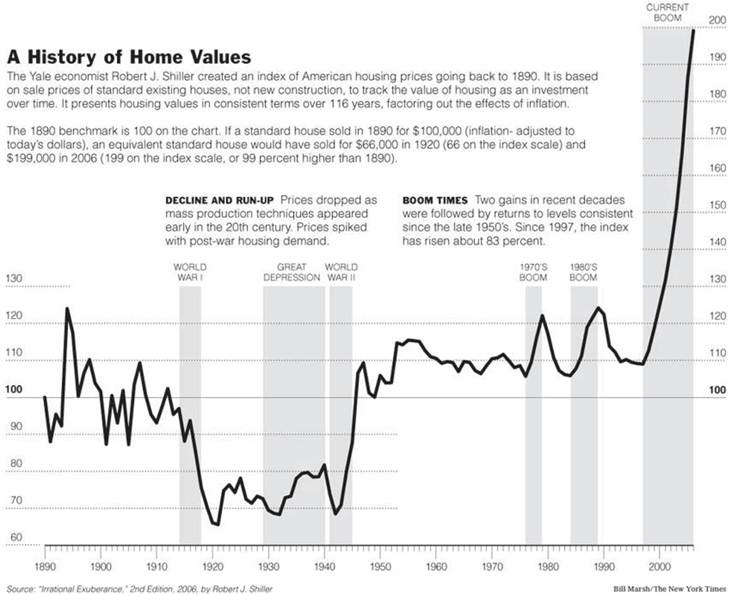
Property Values (cont.)

Slide 12
District Equalized Value
Year | Eq Valuation | Eq Value Increase | Op Levy Increase
2003-04 | $48,849,160,097.00
2004-05 | $53,692,768,639.00 | 9.92% | 6.27%
2005-06 | $59,193,569,157.00 | 10.24% | 5.19%
2006-07 | $64,936,165,589.00 | 9.70% | 5.87%
2007-08 | $68,923,169,014.00 | 6.14% | 5.5%
2008-09 | $72,174,175,738.00 | 4.72% | 5.87%
2009-2010 | $72,289,899,543.00 | .016% | 8.86%
2010-2011 | $70,001,364,576.00 | -3.17% | 8.83%
2011-2012 | $69,257,861,580.00 | -1.60% | 0.0

Slide 13
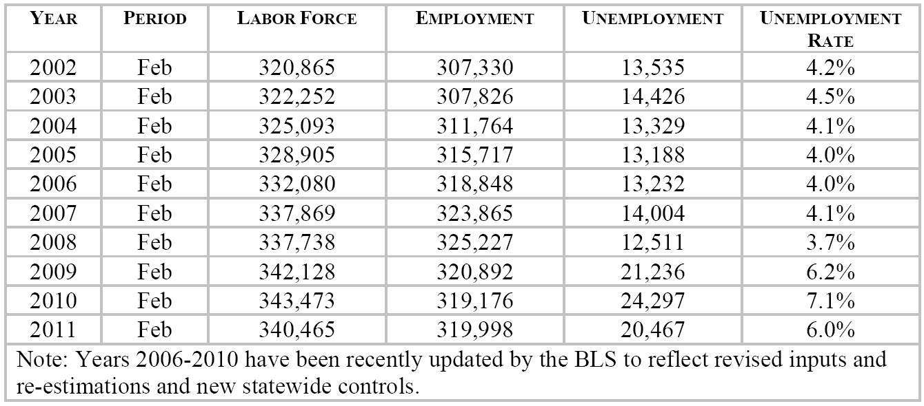
Unemployment and Household Income

Slide 14
Household Income Declining
2010 Census Data shows:
In Madison, median household income dropped 8% from 1999-2010.
In Dane County, median household income dropped 10% from 1999-2010.
1999: $64,410
2010: $58,661
Household Income is the number one predictor of housing prices.

Slide 15
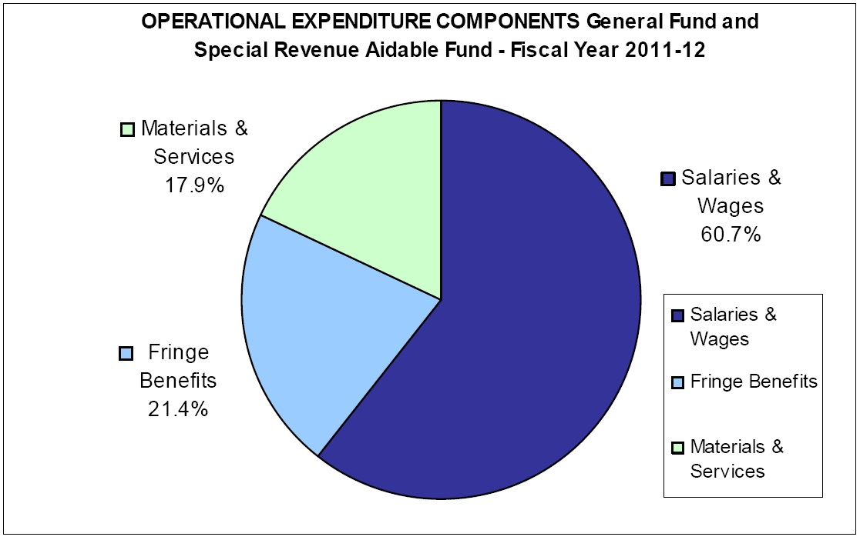
Operating Expenses

Slide 16
Recent Activity
Set Operating Levy at $92,926,000
Set operational mill rate at 1.34174
Last year mill rate was 1.32749
Budget repair bill froze mill rate increases, but college allowed to collect as much as it did last year.
$10,960,000 under statutory cap (1.5 mill).
Set Debt Service Levy at $25,466,167
Set Debt Service mill rate at .36770
Last year debt service mill rate was .14713
Increased total mill rate by 15.92%
Increased total levy by 14.69%

Slide 17
Recent Activity (cont.)
Granted administrative pay raises
Sent notice to Deans that they will be holding off on distributing new operational funding request forms. (No new positions)
Learner Success has created a set of budget priority protocols

Slide 18
Challenges for 2012-13
College currently estimates budget shortfall to be between $3.5 million and $6.5 million
Mill rate frozen for 2012-13
“Renegotiation” of FT contract (March 2011) to grant CPI-level base rate increases has been more expensive than predicted and more expensive than previously bargained language.
3.6% increase in base rate
About $1,000,000 more than originally budgeted

Slide 19
Options
Allow LTE positions to end
Cut course sections
Eliminate vacant positions, or hold open
Eliminate programs
Lay-off staff (January 1 layoff notice deadline)
Eliminate campuses
Outsource

