Slide 1
MATC College Governance
Convocation
October, 2011

Slide 2
Wisconsin Technical College System
System Board Appointed by Governor
The WTCS Board consists of 13 members:
one employer representative
one employee representative
one farmer representative
State Superintendent of Public Instruction or a designee
Secretary of the Wisconsin Department of Workforce Development or a designee
President of the University of Wisconsin System or a designee from among the Regents
six public members
one student representative
The employer, employee, farmer and public representatives are appointed by the Governor for staggered, six-year terms. The student member is appointed by the Governor for a two-year term. All members appointed by the Governor must be confirmed by the Wisconsin Senate

Slide 3
WTCS State Board
Empowered by WI Stat 38 and WI Admin Code Chapter TCS
Set instructor certification standards
Set program approval policies
Set statewide financial rules
Set standards for educational programs

Slide 4
Accreditation Authority
HLC- Higher Learning Commission
North Central Association of Colleges and Schools
AQIP- Academic Quality Improvement Program

Slide 5
MATC Board of Trustees
The governing board of Madison Area Technical College is made up of nine individuals appointed from within the Madison Area Technical College District:
two employers,
two employees,
one school district administrator,
one elected official, and
three additional members.
Madison Area Technical College District Board members are appointed by a committee comprised of the 12 county board chairs from the counties which make up the Madison Area Technical College district: Dane, Sauk, Jefferson, Columbia and Marquette Counties; and portions of Adams, Dodge, Green, Iowa, Juneau, Richland and Rock Counties
Hires and supervises the President

Slide 6
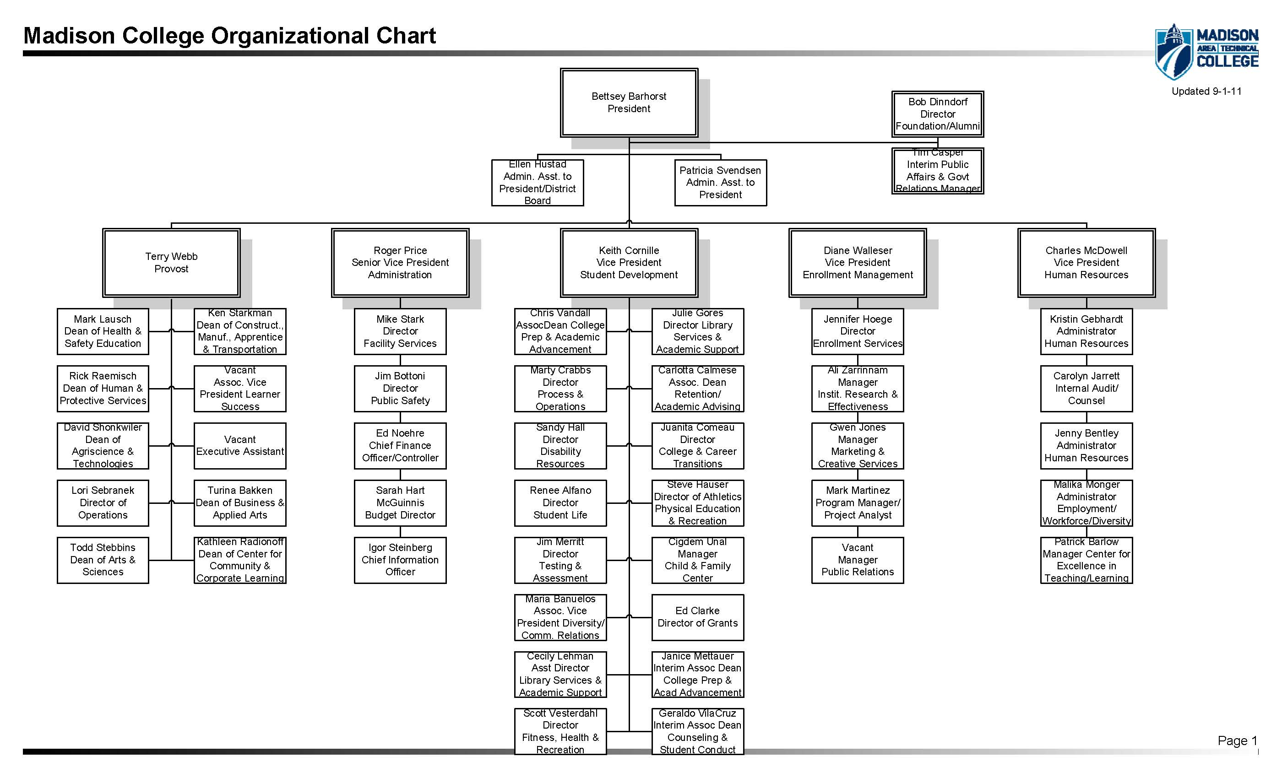
MATC Administration - 2011

Slide 7
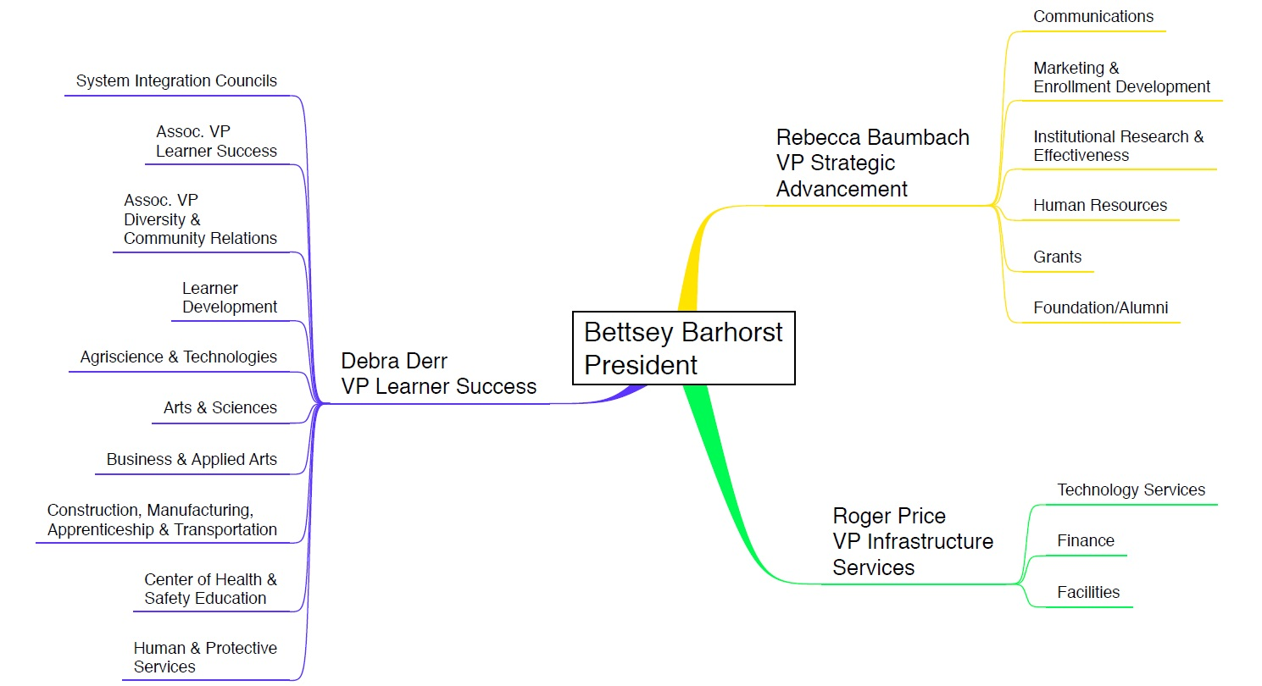
MATC Administration- 2007

Slide 8
College Committees
College Council (replaced by Executive Administrative Council)
College Council Effectively disbanded in 2009
Executive Administrative Council- 2011
Same tasks, but eliminated Part-time Faculty Union Representation
Meets infrequently
System Integration Councils
Academic Policy, Planning and Implementation
Learner Success Technology
MATC Alliance for Environmental Sustainability
Learner Preparedness and Success
Discontinued (Life Long Learning, Economic and Workforce Development)
Inter Cultural Council
ADA Work Team
Part-time Faculty Advisory Council (Discontinued)

Slide 9
Learner Success Leadership
See handout

