Slide 1
Part-Time Faculty Co-op proposal
Convocation Break-Out
8/24/11

Slide 2
What is the “Co-op Proposal”?
Part-time faculty union dissolves and re-organizes as a non-profit corporation (the “Co-op” or “Guild”).
Non-profit corporation forms a wholly-owned for-profit corporation (the employment agency).
Two corporation structure selected for maximum flexibility and to meet IRS requirements.
Organization employs part-time faculty and contracts with college to provide instruction for courses.

Slide 3
Co-op Operations
Co-op will contract with employers to provide instructors.
Instructors will be employees of the Co-op, not the college.
Co-op will perform human resource functions for the instructors.
Co-op will quote the employer a flat rate per contact hour.

Slide 4
Co-op Operations
See handout
Co-op employs PT faculty. Takes responsibility for:
Hiring
Scheduling/ Course assignments
Certification
Training
Sick Leave/ Subs
Evaluation
Professional Development
Payroll
Base pay
Benefits
Mandatory
Optional
Professional Liability

Slide 5
Employer perspective
School provides a list of courses requiring staffing to Co-op.
Co-op provides certified instructors to teach courses, covers absences and conducts annual evaluations.
Multi-year agreements possible for control and predictability of future costs.
School no longer responsible for benefits, unemployment insurance, worker’s comp, tax withholding, payroll, hiring, certification, evaluations, pay calculations or scheduling.

Slide 6
Co-op Operations
Payroll
Contractor Status
Co-op handles bi-weekly payroll
Co-op calculates withholding
Co-op resolves any payroll errors
Co-op tracks use of sick time, if any
Co-op handles all tax paperwork (w-2, w-4, etc.)
College provides list of courses, Co-op provides staff.
Instructors can work at more than one college/ more than one center within a college.
No load limitations
No restriction on PSRP performing PT instructional work
Access to a broader pool of instructors
No tax liability, nor unemployment insurance, nor workers comp.
No exposure to overtime risk for college

Slide 7
Co-op Operations
Hiring
Certification
Co-op solicits staff/ headhunts
Co-op processes new hire paperwork
Co-op completes reference checks
Co-op completes certification paperwork
Co-op handles employee orientations
Certification information for employees accessible through employee portal
Contract with MATC for certification courses under 38.14
On-line versions of each certification course
Requests for additional course certification handled by Co-op
Co-op indemnifies college against any certification-related fines/forfeitures

Slide 8
Co-op Operations
Evaluation
Course Assignment
All instructors peer evaluated once per year
Peer evaluators compensated on a per evaluation basis
Evaluation results normalized for each reviewer
Evaluation score factored into course assignment protocol
Employer request for particular staff person pulls a course out of the automated assignment process
Pre-screening creates list of candidates based on certification, workload and availability
Staff members are prioritized for course assignments based on uniform, transparent criteria including:
College seniority
Co-op seniority
Student review scores
Peer evaluations
Availability and scheduling managed through a web portal

Slide 9
Contract
Clearly quoted price per course (based primarily on contact hours) makes budgeting very easy
Full organizational cost of course staffing captured in a single price quote
Multi-year contracts possible if the college wants to manage future costs
Maximizes flexibility for college in course offerings
Provides an affordable means to expand course offerings as new construction occurs
Provides access to a larger pool of part-time faculty
Provides workforce stability

Slide 10
Quality Improvement Projects
Year One- see handouts
Learner Elective Course Formatting- 100 courses/yr
Textbook-free course design- 50 courses/yr
Course Portfolios
38.14 “Employee Ambassador” program

Slide 11
Benefits to MATC
Cost Savings- $3 million dollars/yr. +
Ability to front-end load savings, potentially covering entire 2012-2013 budget shortfall
Ability to spread impact of current shortfall over 2-3 years
Co-op, as private company, can borrow for operating expenses
Achieve cost savings through retirements and natural attrition, minimizing layoffs
Repurpose staff into revenue-generating functions
Improve quality of Part-Time Faculty and part-time faculty support
Improve quality of instruction
No course cancellations or program eliminations
Allows full staffing of new buildings
Substantial process improvements vs. current system

Slide 12
Benefits to FT Faculty and PSRP
Avoid/minimize layoffs
No restrictions on PSRP teaching part-time
Avoid program eliminations
Avoid class size increases
Creates “breathing room” to repurpose or reposition staff
Achieves cost savings through efficiency improvements, not by piling more work onto existing staff

Slide 13
Value of Innovation
Budget problem is long term- not short term.
Even when Walker levy freezes are lifted, college will hit its levy cap in 2 years or less.
Pay gap got much worse this year.
15-24 year old district population in 10-year downward slide.
Potential to be a national model for PT faculty.
Ability to demonstrate a real commitment to fiscal responsibility.
Ability to take meaningful steps to repair the relationship with Part-time faculty.
Huge PR benefit from adoption. Huge PR disaster from rejection.

Slide 14
Convergence of Two Trends
Operating Levy Ceiling
PT/FT Pay Gap

Slide 15
Fiscal Background Info
Budget problem is a long-term problem, not a short term problem.
Walker legislation accelerated crisis.
Even without Walker limitations, MATC will hit its levy cap in two years or less.
Equalized value of district trending down
Residential property is 70% of the total value of the district
15-24 year old district population will experience 4% decline from 2010-2020. (2000-2010 was 7% increase)

Slide 16
WI Residential Value Projections
Source: Wisconsin Taxpayers Alliance. “Property Values Down, but Bubble Remains.” 8/27/2010

Slide 17
Impact of Housing Bubble on Equalized Value of Property in District
Rapid increases in housing prices led to Rapid increases in Equalized Value of District.
This allowed consistent increases in operational levy of more than 5% per year, without these increases being consistently reflected in the mill rate.
Slowed rate of price increases in housing in 2007 and 2008, followed by price decline, has rapidly pushed the mill rate towards the 1.50 cap.

Slide 18
Impact of Future Equalized Value Changes on Operating Levy
Once the mil rate hits 1.50, the percentage increase in operating levy is limited to percentage increase in the equalized value of the property of the district.
The 20 year average levy increase for MATC is 7.1%.
The average MATC operating levy increase from 2003 to 2010 is 6.63%.
Once the mil rate hits 1.50, these levy increases are only sustainable if the equalized value of the property in the district increases at 6.63% per year.
From 1960-2000, the long term trend in US housing prices was the rate of inflation plus 0.2%.

Slide 19
Operational Levy Increase
Year | Operational Levy | Levy increase %
2003-04 | $59,341,471.19
2004-05 | $63,063,767.55 | 6.27%
2005-06 | $66,334,089.40 | 5.19%
2006-07 | $70,227,164.36 | 5.87%
2007-08 | $74,086,203.60 | 5.50%
2008-09 | $78,432,398.52 | 5.87%
2009-10 | $85,383,769.05 | 8.86%
2010-11 | $92,926,111.46 | 8.83%

Slide 20
Pay Gap
Insulting/ demoralizing/ infuriating to PT faculty
Lethal to FT faculty

Slide 21

Outside Sources of Information
IPEDS Database
http://nces.ed.gov/ipeds/
State System Data
WTCS System Data
State Budget Data
Legislative Audit Bureau Data
Internal Documents
Budget Documents
Accreditation Documents
Board Documents

Slide 22
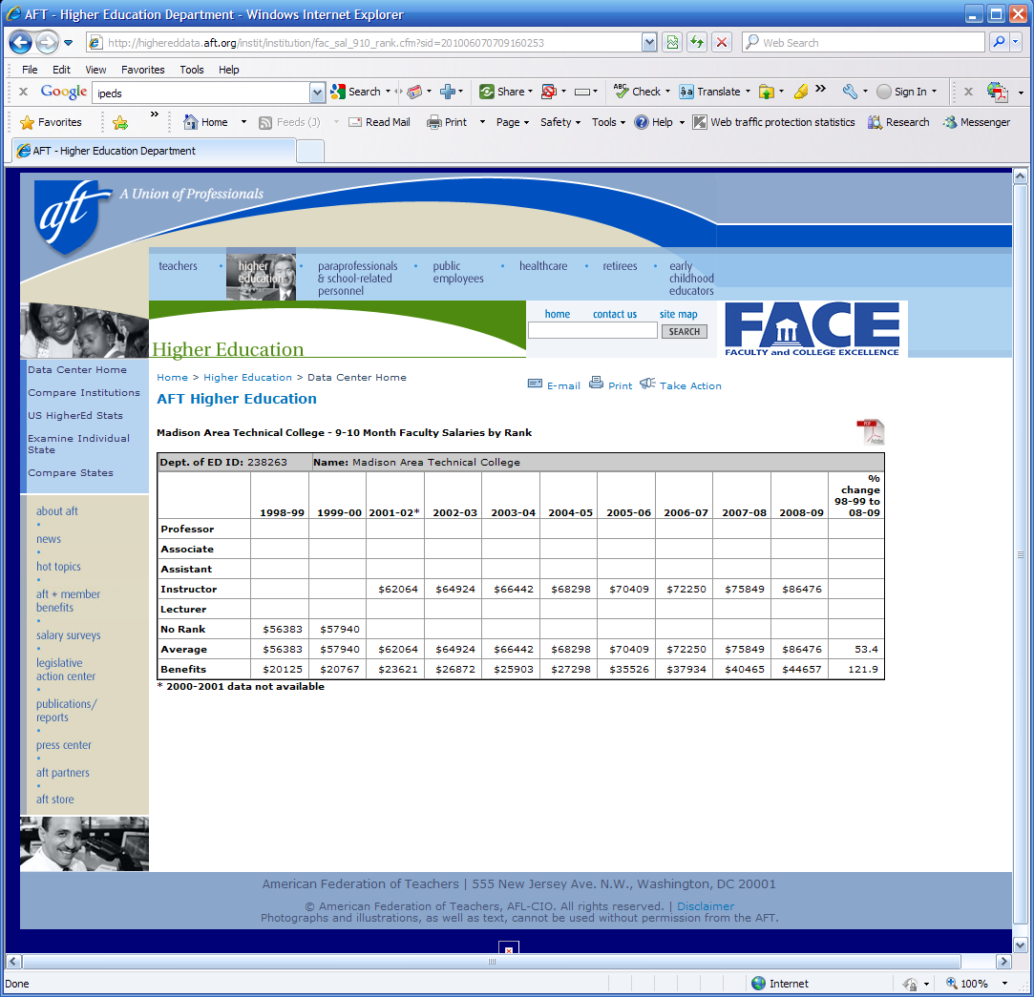
Sample of Data
retrieved regarding
MATC FT Faculty

Slide 25
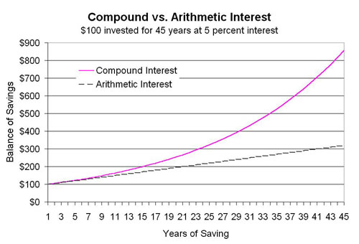
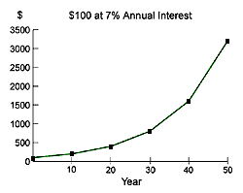
The Compound Interest Curve
The “Widening Gap” phenomenon is due to the compounding effect of raises over time. If the percentage increases are the same for PT and FT faculty, the gap in compensation will inevitably grow wider.
The slope of the curve increases over time. This means that the “gap” problem will grow worse at an accelerating rate. FT compensation pulls away from PT compensation and the dollar difference gets bigger and bigger and bigger.

Slide 26
Mathematical Inevitability
Over time, it becomes economically indefensible to have courses taught by Full Time Faculty, particularly in the absence of any significant difference in the quality of instruction, tuition paid, or instructor credentials.

Slide 27
Impact of Colliding trends
Revenues Limited/Frozen
“Premium” for FT faculty increasing at accelerating rate
Shift to PT faculty is inevitable
Current PT faculty business model is harmful to the educational mission of the college.
How successful can the college be if, 10 years from now, 75% of its courses are taught by angry, disengaged, poorly compensated, part time faculty who turn over at a rate of 35% per year?

